Slide 1
Child Abuse Prevention Month: How & Why?
Mrs. Mayra Flores, Safe Environment Coordinator, Archdiocese of Chicago
Dr. Heather Banis, Victim Assistance Coordinator, Archdiocese of Los Angeles

Slide 2
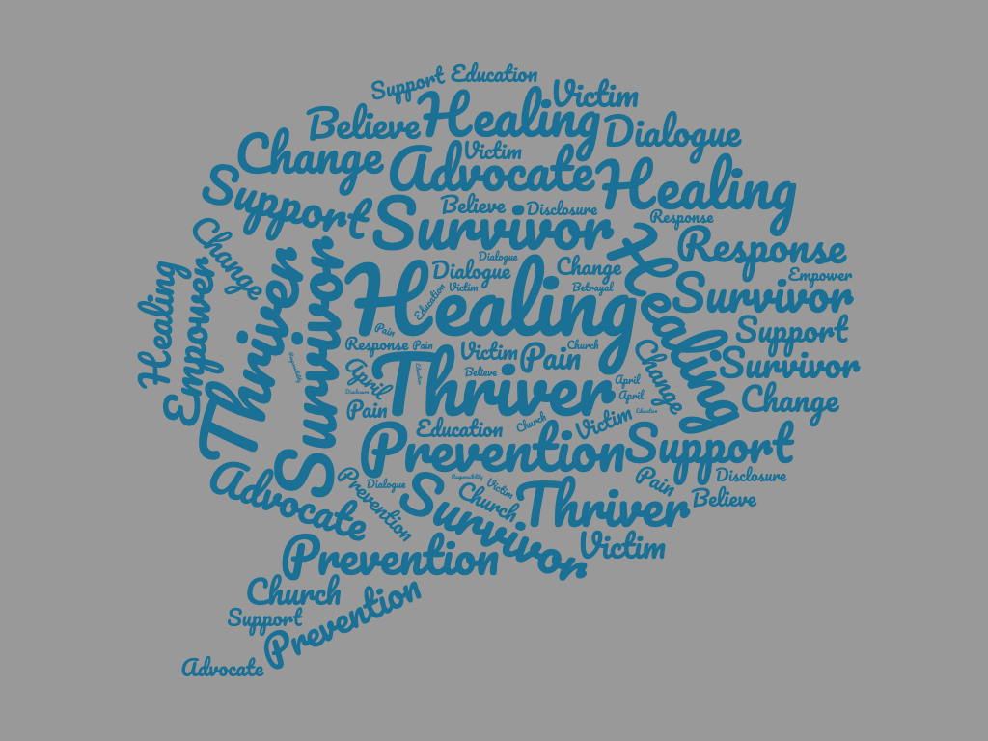

Slide 3
Listen and Learn
The Church has been, and is, listening and learning
Real changes have occurred and have been impactful
Programs have been developed and implemented because of what was learned
Growth is ongoing

Slide 4
Acknowledge and Honor
Victim-survivors’ stories are being heard and acknowledged
Victim-survivors’ experiences have transformed the Church’s understanding of the clergy sexual abuse phenomenon and informed our practices
Steadfast vigilance in safe environment practices honors those who were harmed – we have evolved from “crisis” mode – we are diligently planning and managing safe environment practices and their implementation
As a result, we have safe environment practices that are commonplace today – like buckling a seatbelt is to riding in a car

Slide 5
Demonstrate Trustworthiness
April is an opportunity to highlight the ongoing efforts in child protection and safe environment happening every day in parishes across the country
April gives us the chance to recommit ourselves to these efforts

Slide 6
Pinwheels for Prevention
Child Abuse Prevention Month

Slide 8
Child Abuse Prevention Month
Virtual Prayer Service
Lord’s Prayer can be found here: https://wetransfer.com/downloads/3fa56a5275f1b68d5619e7edd4455a6820210408123245/93730fe67d9697ac8e0ca56b19b7cf9e20210408123326/6fb811
Launch – Friday, April 9, 2021
Accompanying Worship Aid
Handout for Trusted Adults – Disclosures from Children

Slide 9
Announcement
Please join us virtually for the 10th Annual Pinwheels for Prevention Prayer Service on April 9, 2021. It is an opportunity to gather to raise our voices in song and prayer to advance awareness during Child Abuse Prevention Month. Along with Cardinal Cupich, Church leaders and other trusted adults, we join with children and youth from throughout the Archdiocese in praying for the eradication of child abuse in all its heinous forms. The worship guide and other support material (“Listening Do’s & Don’ts Related to Child Disclosures of Abuse” handout, pinwheel coloring page) are available here [link].

Slide 10
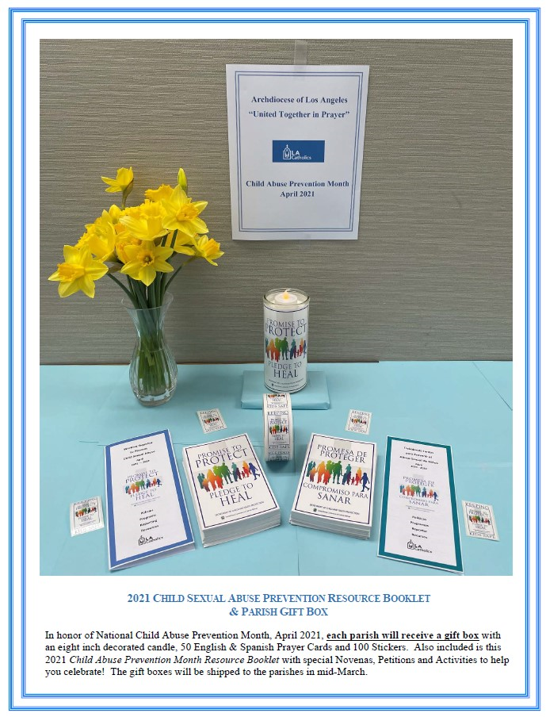
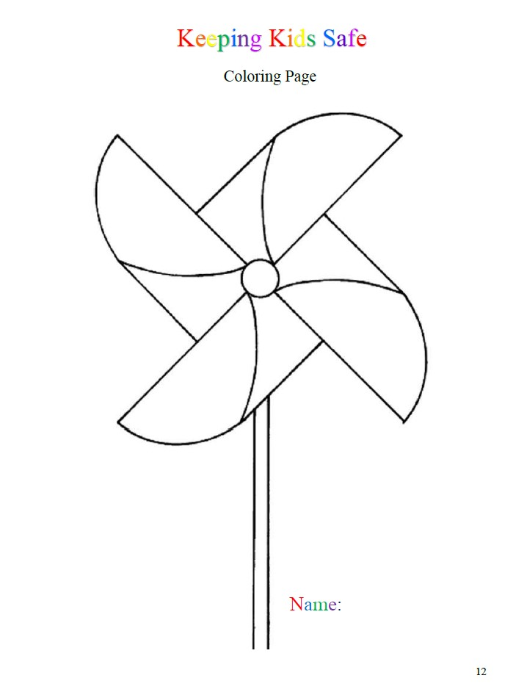
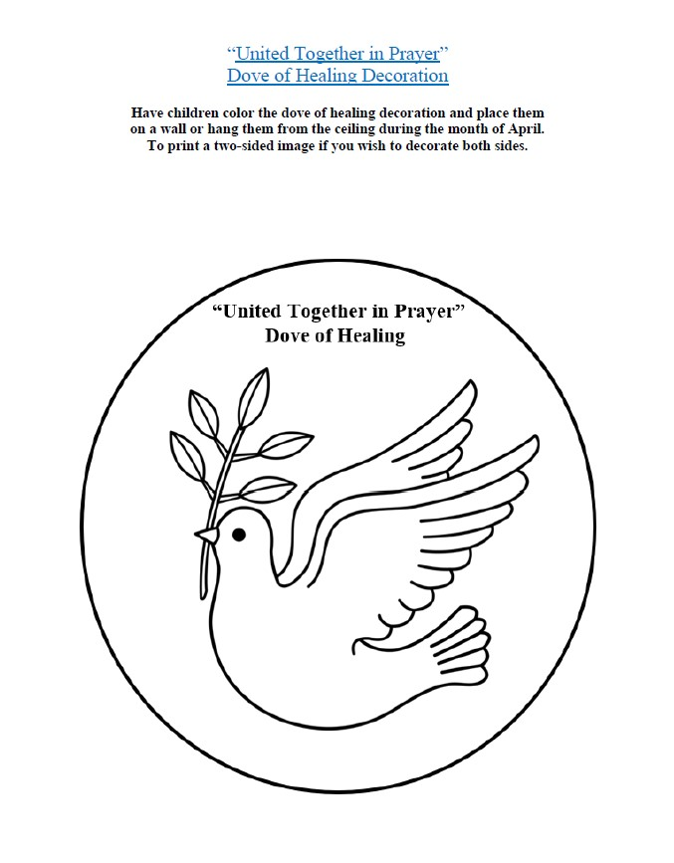
Archdiocese of Los Angeles Safeguard the Children Child Abuse Prevention Materials 2021

Slide 11
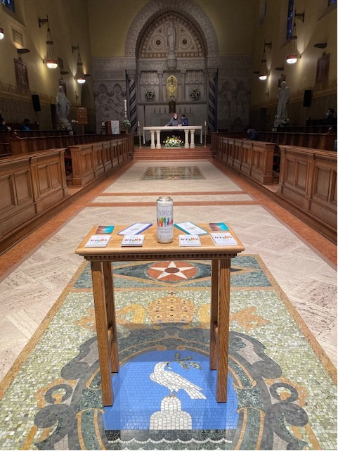
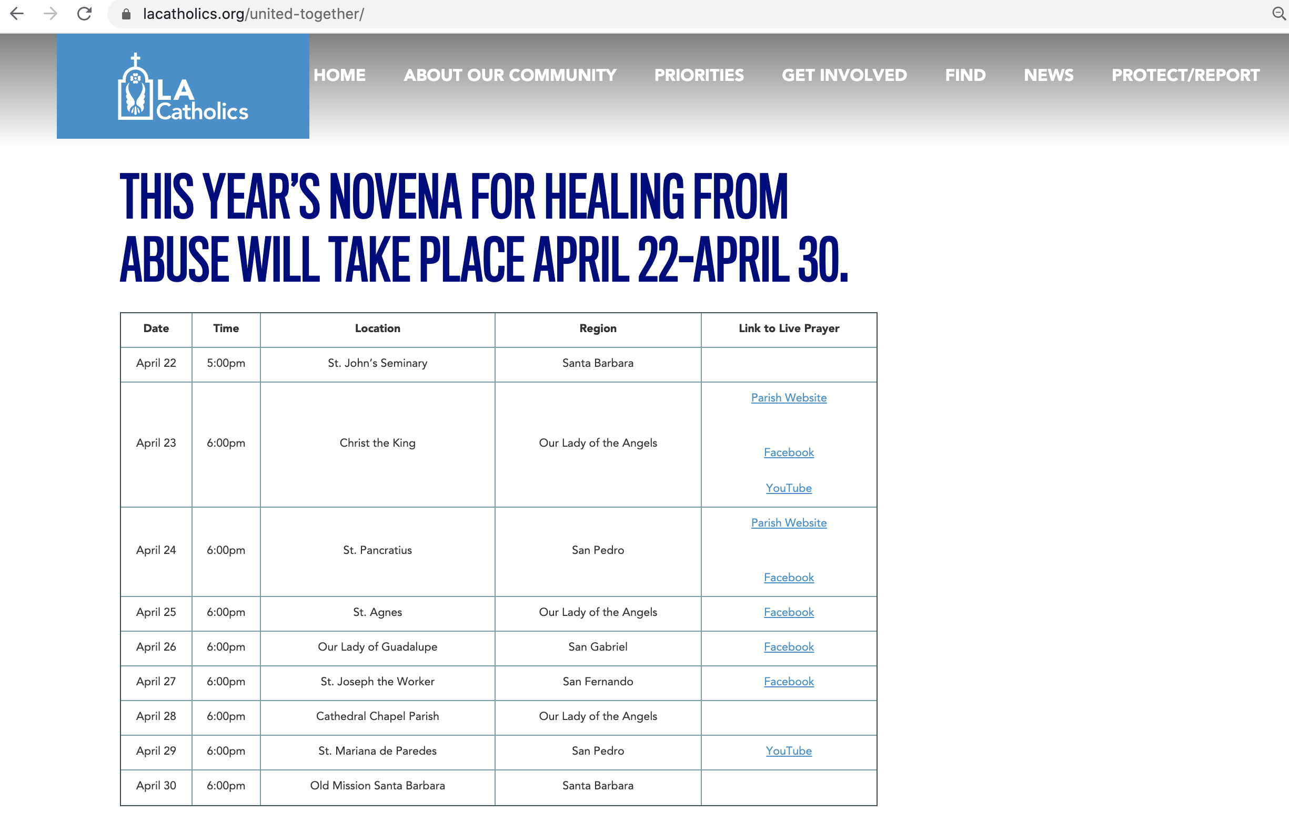
Novena for Healing from Abuse 2021
Join Novena: lacatholics.org/united-together or facebook.com/lacatholics

Slide 12
Just getting started?
California VAC call monthly – share ideas, resources, advice
Start where you have strong support already in place
Redefine success – a healing service offered vs. attendance of 300+
Be imaginative – how might the seminary be involved, or a local parish with a history of abuse, or perhaps there could be a victim-survivor-led program

Slide 13
Questions/Comments
Mrs. Mayra Flores: mflores@archchicago.org
Dr. Heather Banis: hbanis@la-archdiocese.org
Secretariat of Child & Youth Protection: scyp@usccb.org

